Slide 1
(a) First Phase
Model A
Model B
Model C
Model D
(b) Second Phase
Model A
Model B
Model C
Model D

Slide 2
 | Model A | Model B | Model C | Model D
Accuracy | 0.7463 | 0.7671 | 0.7254 | 0.7373
Precision | 0.5574 | 0.6145 | 0.4437 | 0.9745
Recall | 0.6986 | 0.6986 | 0.9930 | 0.2405
F1-score | 0.6201 | 0.6538 | 0.6133 | 0.3858
 | Model A | Model B | Model C | Model D
AUC | 0.7557 | 0.7186 | 0.7040 | 0.6491

Slide 3
Validation Metric | Seed 1 | Seed 2 | Seed 3 | Seed 4 | Seed 5
Mean accuracy | 0.6427 | 0.5990 | 0.6952 | 0.6758 | 0.6291
Mean precision | 0.5855 | 0.6652 | 0.6938 | 0.6707 | 0.5610
Mean recall | 0.6742 | 0.5716 | 0.6366 | 0.5810 | 0.7367

Slide 4
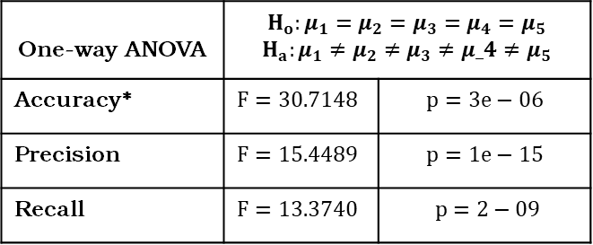
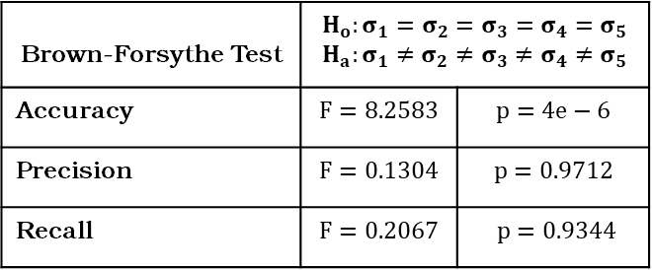
Brown-Forsythe Test | $$H_{o}:σ_{1}=σ_{2}=σ_{3}=σ_{4}=σ_{5}$$ $$H_{a}:σ_{1}≠σ_{2}≠σ_{3}≠σ_{4}≠σ_{5}$$
Accuracy | $$F=8.2583$$ | $$p=4e−6$$
Precision | $$F=0.1304$$ | $$p=0.9712$$
Recall | $$F=0.2067$$ | $$p=0.9344$$
One-way ANOVA | $$H_{o}:μ_{1}=μ_{2}=μ_{3}=μ_{4}=μ_{5}$$ $$H_{a}:μ_{1}≠μ_{2}≠μ_{3}≠μ_4≠μ_{5}$$
Accuracy* | $$F=30.7148$$ | $$p=3e−06$$
Precision | $$F=15.4489$$ | $$p=1e−15$$
Recall | $$F=13.3740$$ | $$p=2−09$$

